Slide 1

CitiusCloud Product Development IPAM
IPAM Requirement:
To provide free ip for Calm Automation irrespective of hypervisor(AHV, Esxi,…)
Affordable price, simple product
Product can be independent or works with CC-Service Desk Product

Slide 2
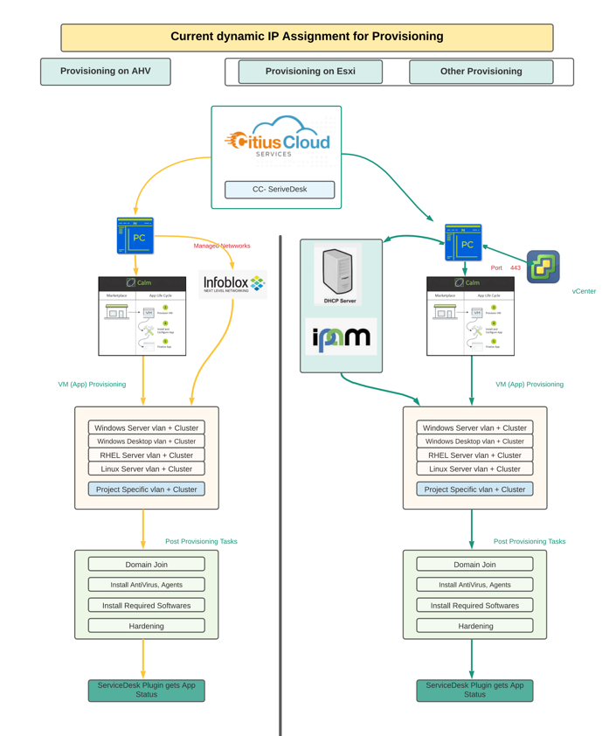
Dynamic ip assignment to vm

Slide 3
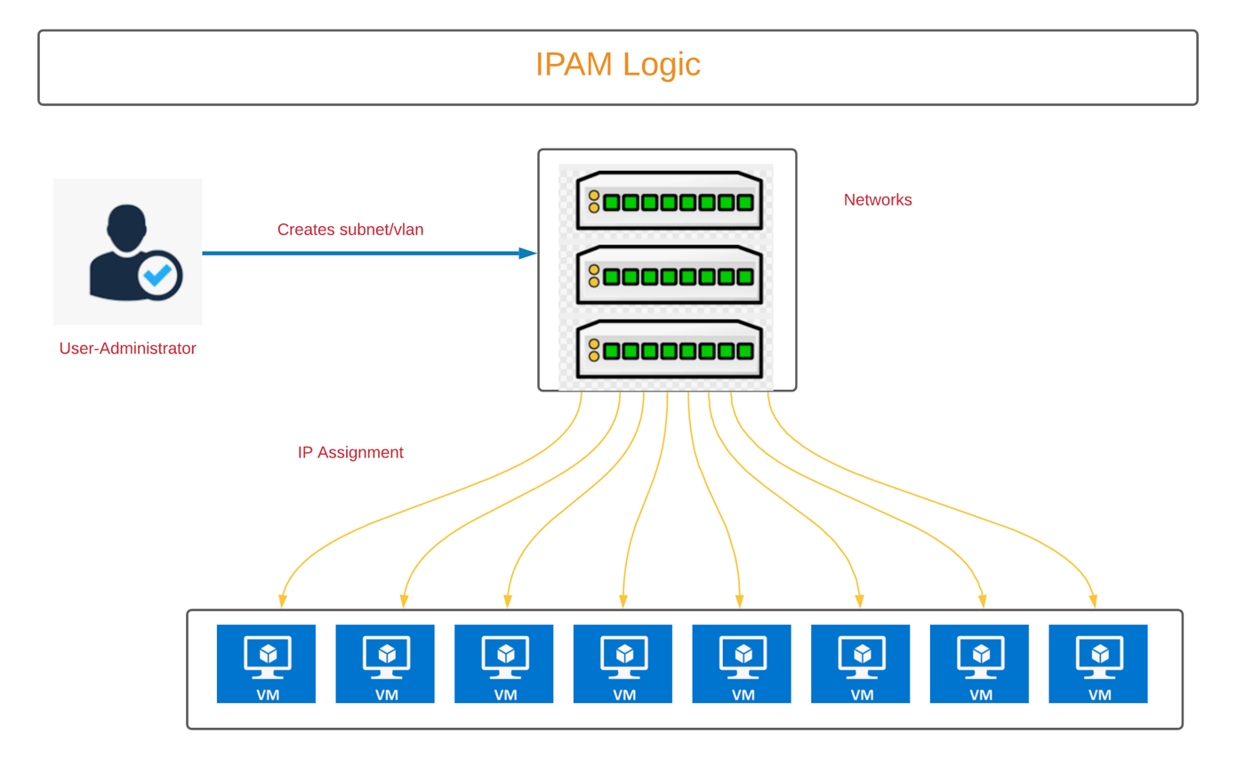
CitiusCloud IPAM Logic

Slide 4

CitiusCloud IPAM Solution
Ipam Administrator can create, delete networks.
Automatic subnet calculation made and maintained in DB
Exclude range of ipaddress in network is possible.
IPAM Automation
Get free ips can be achieved from UI or Rest Api call.
Hostname updated to ipaddress when ip assigned. While vm decommissioned, ip get released.
IPAM project got dockerized –Easy deploy on anywhere with docker desktop.

Slide 5

Many thanks to Vikram in mentoring ☺
What Next ?
Demo2 on end of October with standard UI and Validation
Unit test by team, bug fix – November
Convert the project as Product(Msi) and Kubernetes implement for HA -December

